Slide 1
JavaScript Framework Comparison

Slide 2
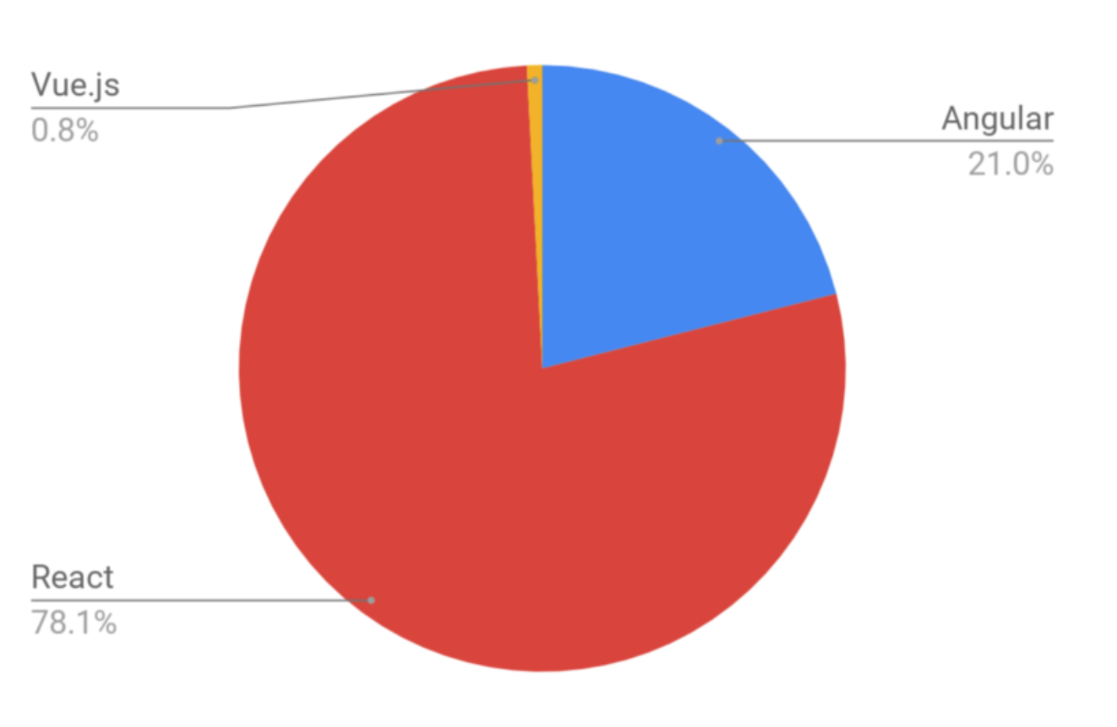
Three Primary Competitors
React
Angular
Vue

Slide 3
Developed by Facebook in 2011
Open Sourced in 2013
Very Popular
Is just a library. Used for building and rendering components (no other features)
Routing (React Router), State Management (Redux) have to be added manually (provided by community)
Everything is Javascript (but can use JSX which is essentially Javascript for html)
Primarily used for web apps but can be used to develop mobile apps via React Native
Facebook, Uber, Netflix, Twitter, Udemy, Paypal, Reddit, Tumblr, Walmart

Slide 4
Hello World - React

Slide 5
History of Angular
In 2010, Google employee, Misko Hevery, developed a side project to help him build web applications easier. Named AngularJS (Angular because of the <> of HTML)
The Google core team wanted to deliver 2.0 but not be shackled by certain designs from the first iteration
Completely redesigned and changed it into a full framework. Released in 2016
Developers panicked because they were nothing alike (No clear migration strategy and all current AngularJS apps were now outdated)
However, Angular2 had some significant upgrades…

Slide 6
AngularJS vs Angular2+
Modular programming concept
JS Library
No TypeScript
Uses controller and Scope
Easy setup (just add reference to library
Doesn’t use camelCase syntax
DI is achieved via controller
Limited Mobile Support
Component based programming
Complete Framework
Uses TypeScript to add strong typing
Uses component and directives
Difficult setup (Other library dependencies)
Uses camelCase for built-in directives
DI is achieved via constructors
Extended Mobile Support
It is faster than AngularJS in every aspect

Slide 7
Angular2
Extremely popular as well (Slightly less than React)
Developed and maintained by Google
Complete platform for building reactive, component-driven apps
Uses native Web APIs, HTML templates, and CSS
Coded in Typescript (which must be learned)
Routing, State Management, HTTP is all included by Angular by default
Primarily used for Web Apps
Google, Forbes, WhatsApp, Instagram, healthcare.gov

Slide 8
Vue
Created by Evan You after working for Google and using Angular JS extensively (Not backed by a huge company).
Not used by many businesses as it’s still gaining popularity
Originally released in February 2014
“I figured, what if I could just extract the part that I really liked about Angular and build something really lightweight.”
Very easy to learn and good for beginners
Complete framework like angular but not as many features
Allows you to build reactive, component-driven apps
Uses native Web APIs, HTML templates, and CSS (Similar to Angular but has many ideas similar to react)
Routing, State Management is all included by default while other features are provided by community
Primarily used for web apps but can be used for mobile apps
Alibaba, GitLab, Baidu

Slide 9
Hello World - Vue

Slide 10
Getting Started - React
Pros
JSX is optional
Can be dropped into existing web/apps/views
Cons
Steep learning curve (not as bad as Angular)
JSX can be difficult to learn if you want to use it
Need to add a lot of features for SPAS

Slide 11
Getting Started - Angular
Pros
Uses HTML and CSS in a well-known way
Core features are included and fit nicely
Cons
Steepest learning curve of the three
Need to learn Type Script and DI can be difficult to learn
Complex setup

Slide 12
Getting Started - Vue
Pros
Core features are included and fit nicely
Can be dropped into existing web/apps/views
Intuitive syntax and core features provided by core team
Very easy for junior developers to learn
Cons
Have to add more features for complex projects
Lacks testing guidance

Slide 13
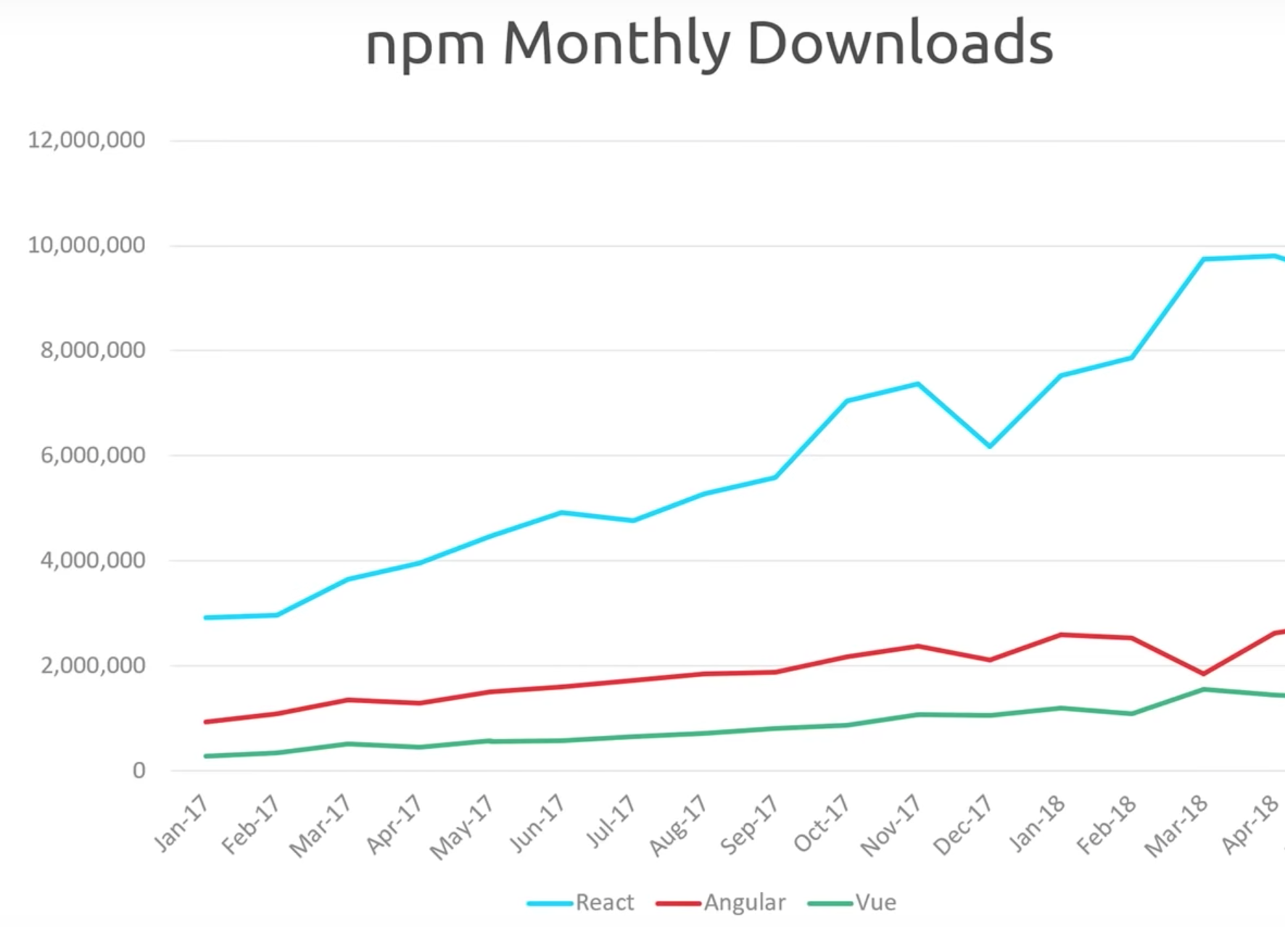
Popularity

Slide 14
Performance
The three frameworks are comparatively faster than all other JavaScript Frameworks.
You should not use performance as the primary factor in choosing between these three options
https://rawgit.com/krausest/js-framework-benchmark/master/webdriver-ts-results/table.html

Slide 15
What to choose?
If you like flexibility more than other features, use React.
If you love coding in TypeScript, use Angular.
If you love JavaScript, use React.
If you are a fan of clean code, use Vue.
Vue provides the easiest learning curve and it’s an ideal option for beginners.
If you want separation of concerns in your application, use Vue.
If you like object-oriented programming, use Angular.
Vue is ideal for a small team and a small project. If your app seems to be large and has significant future expansion plan, pick React or Angular.
For cross-platform app development, React Native is an ideal choice as it provides modern functions and you can easily find resources. Angular, on the other side, needs a sound knowledge of JavaScript to build large-scale applications.

Slide 16
Summary
React and Angular currently dominate the market but Vue is rising quickly in popularity amongst developers.
Like anything, choosing the best JavaScript framework depends on many factors. Choose which fits the best for you!
https://tutorialzine.com/2016/03/5-practical-examples-for-learning-vue-js

